Slide 1

Economic Impact Analysis of
Changing River Flow Requirements
Gary Dorris, PhD
Alankar Sharma

Slide 2
Fundamentally Flawed River Flow Requirement Proposals
Increased water diversions will adversely affect
local communities, property values,
revenues and taxes, local agriculture,
and the statewide economy.
As a result,
the three river flow requirements proposals
(NMFS, USFWS, and CDFW—all fundamentally flawed)
must not be implemented.
Farmers deserve—and must have—water rights!

Slide 3
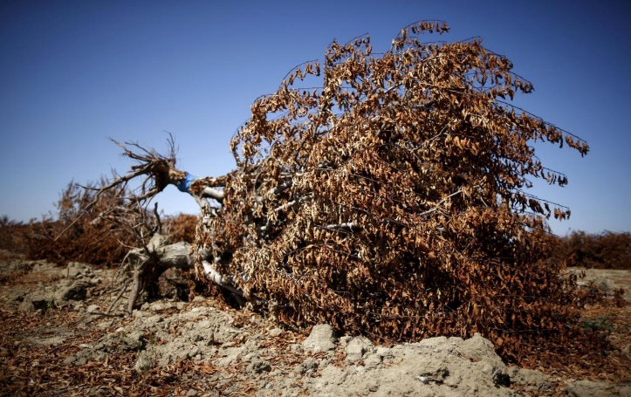
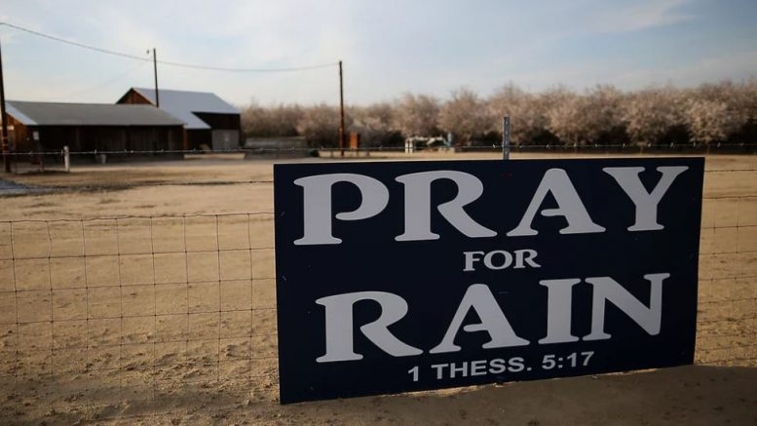
Agriculture Analysis of River Flow Requirements
Turlock Irrigation District retained Ascend as an independent economic consultant to estimate the direct and secondary effects of newly proposed river flow requirements on the value of agriculture in TID. This presentation contains an objective assessment of the economic damages to TID that would be caused under the proposals for river flows drafted by:
National Marine Fisheries Service (NMFS)
US Fish and Wildlife Services (USFWS)
California Department of Fish and Wildlife (CDFW)

Slide 4
Our Major Points
Our Analysis: Study timeline for two valuation analysis approaches: Ascend and UC Davis IMPLAN Multiplier
The Larger Picture: Local and state agriculture significance and economic impact
Three Flawed River Flow Requirements: Flawed and incomplete proposals reduce water flow that adversely affects the agricultural economy
Agricultural and Economic Consequences: Greater water variability leads to crop reductions and devaluation; agricultural losses; dairy losses; population migration; and property value, income, and revenue losses.
Financial Losses: $287 Million to $408 Million loss annually

Slide 5
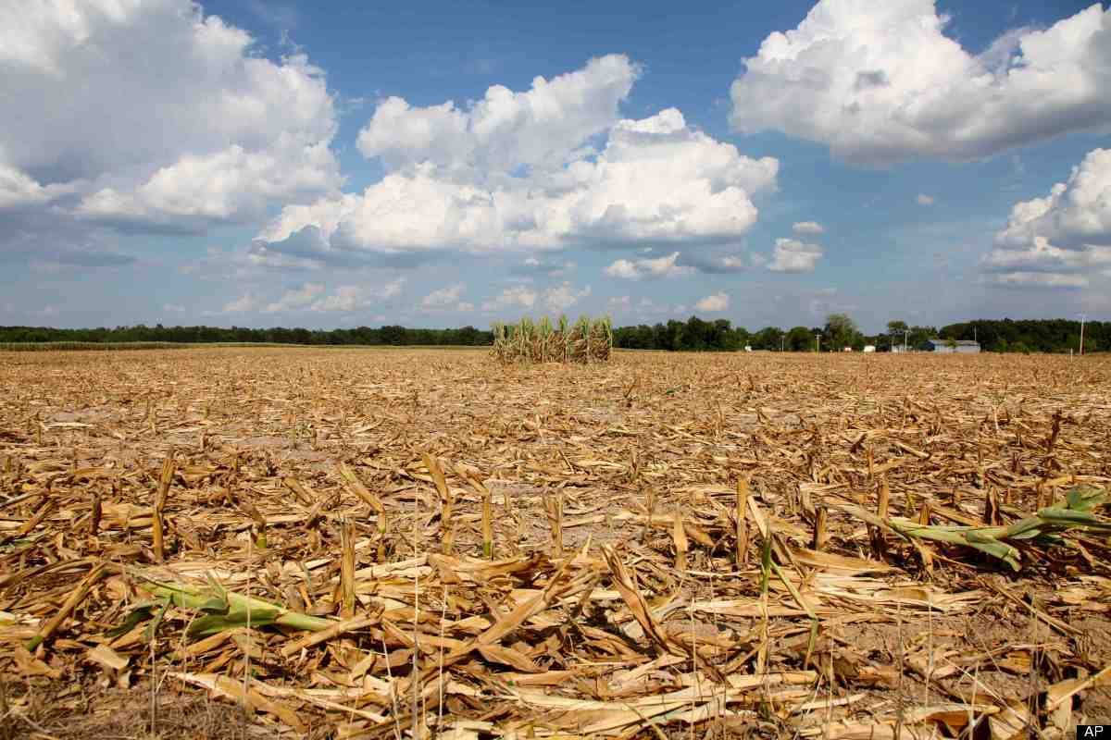
Our Analysis
Study timeline for two valuation analysis approaches:
Ascend and UC Davis IMPLAN Multiplier

Slide 6
Ascend Study Timeline
Ascend’s analysis takes place over a
15-year historical timeline, super-imposing current agricultural values and crop mixes
Three droughts in Ascend timeline:
  2001–2002
  2007–2009
  2012–2015
CDFW’s proposal reduces water diversions
in 2014 by 96% & in 2015 by 86%
Applied Water was determined by scaling results from TID’s analysis on water diversions to DWR’s historical data on applied water for the region
Notes:
Delete?

Slide 7
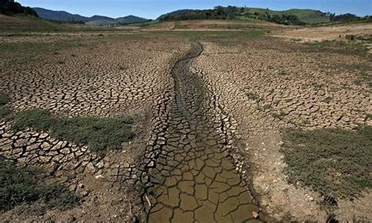
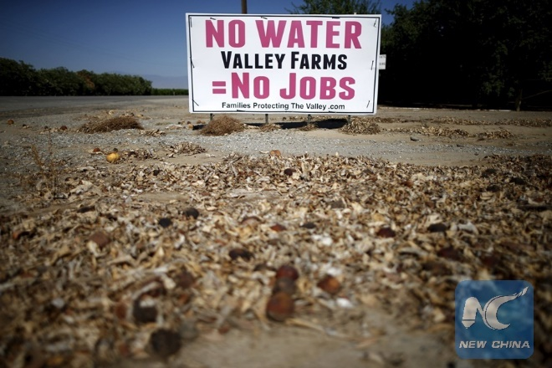
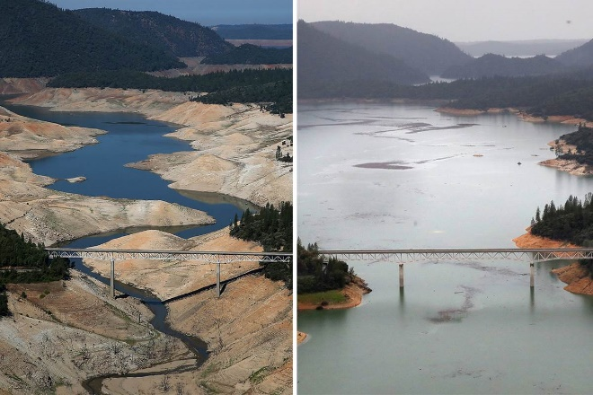
Ascend Economic Valuation Approach
Accounts for the ripple effects that occur after a drought, building upon the previous UC Davis IMPLAN multiplier for upfront agricultural damages
Accounts for the irreversible damage to tree crops and agriculture business under critical drought years
Identifies a dollar value on the change in population after a drought
Identifies a multitude of adverse effects on tax revenue, property values, regional income loss, and the dairy industry

Slide 8
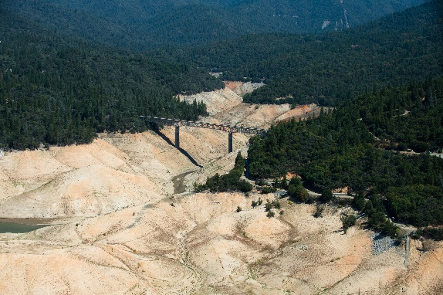
The Larger Picture
Local and state agriculture significance and economic impact

Slide 9
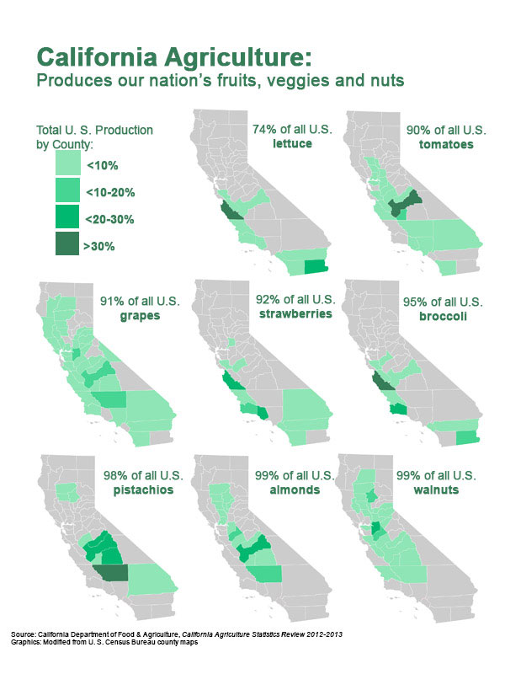
California: Significant Impact on National Industry
California agriculture is $54 Billion industry; generates $100 Billion in economic activity
California produces the most agricultural products of any state
Forbes named agriculture as one of the top industries driving GDP growth in California
25% of California is farmland
33% of America’s vegetables are from California, 67% are from the nation’s fruits and nuts

Slide 10
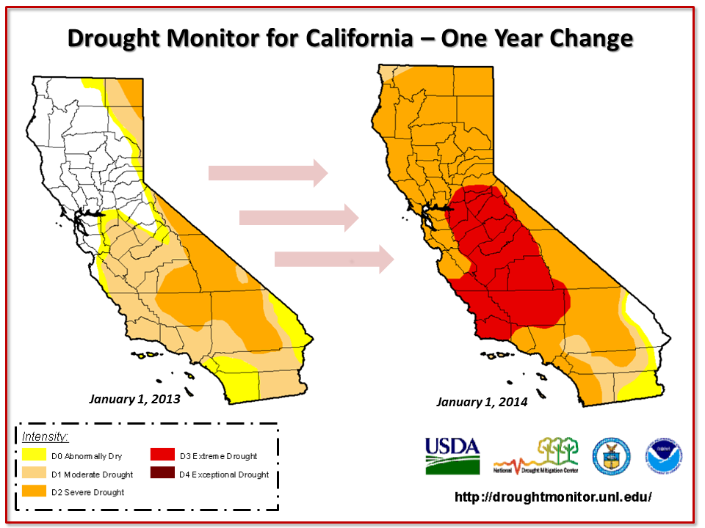
Agriculture Depends on Water: Droughts
U.S. agriculture accounts for 87% of fresh water use
Severe droughts are increasing in commonality due to climate change
Droughts lead to severe agriculture losses, job losses, decline in property value, and can have large effects on the community
Turlock
Notes:
https://www.newsdeeply.com/water/community/2016/02/26/droughts-economic-impact-on-farmers

Slide 11
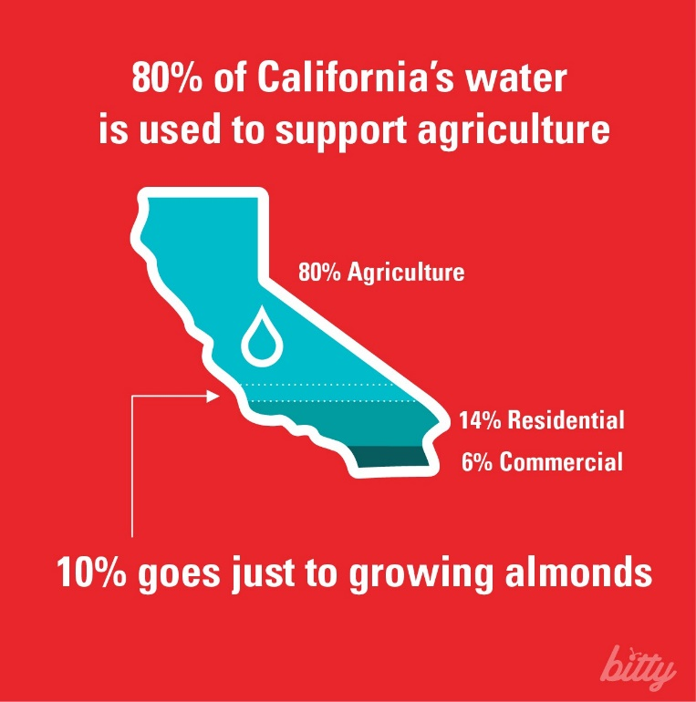
Agriculture Depends on Water: Shortages
California water diversion proposals decrease water reliability for agricultural products which could lead to irreversible damages
Notes:
https://www.newsdeeply.com/water/community/2016/02/26/droughts-economic-impact-on-farmers

Slide 12
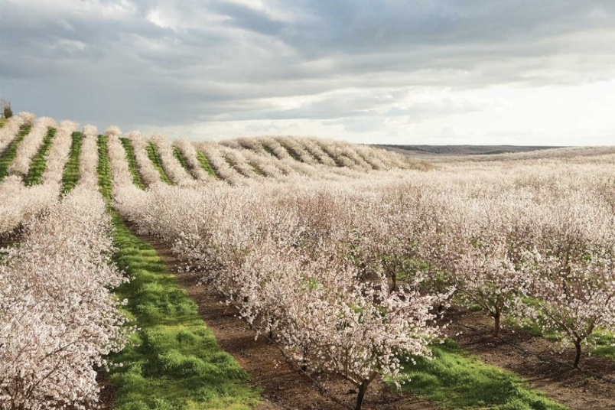
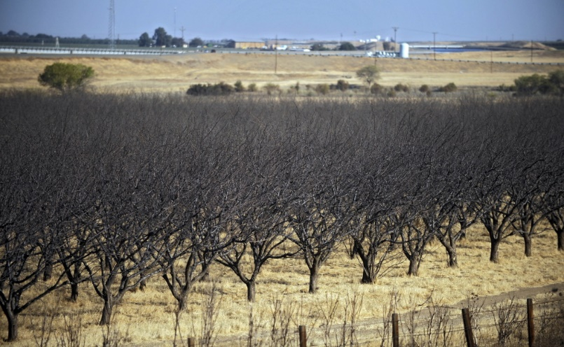
Turlock Agriculture
One-third of Turlock citizens work in agriculture (the highest percentage)
Turlock ranks as one of the nation’s top agricultural counties
Produces $3.2 B in gross farm income
Affordable and adequate water supplies enables a successful agricultural industry
Centered in Stanislaus county, which includes 20% of state agricultural acres

Slide 13
Three Flawed River Flow Requirements
Flawed and incomplete proposals reduce water flow that
adversely affects the agricultural economy

Slide 14
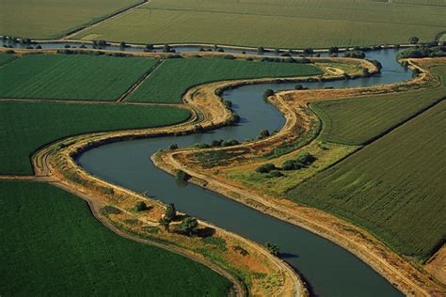
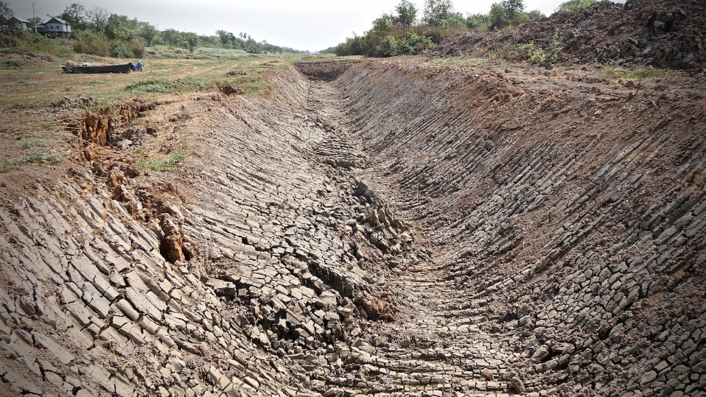
Proposals & Water Flow
Proposed river flow water reduction exacerbate severe drought conditions for 2014–2015:
  NMFS –38.5%
River flow restrictions during severe drought conditions lead to irreversible damages of tree crops—the agricultural foundation of Turlock
As previous droughts have shown, insufficient water severely impacts areas outside of the agricultural industry
  USFWS –35.1%
  CDFW –38.1%
–>

Slide 15
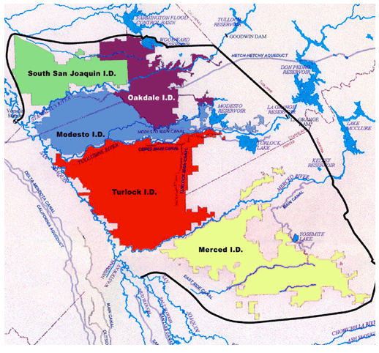
Impacted Areas from Water Flow Reductions
The three proposed river flow reductions impact flow requirements along the Tuolumne River
Current analysis focuses on agricultural and other indirect impacts in TID exclusively
Area of analysis

Slide 16
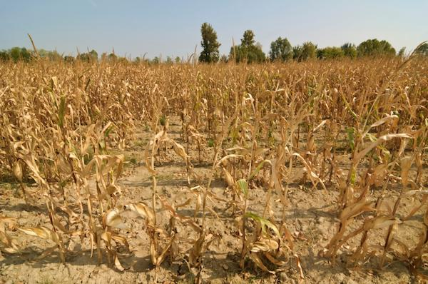
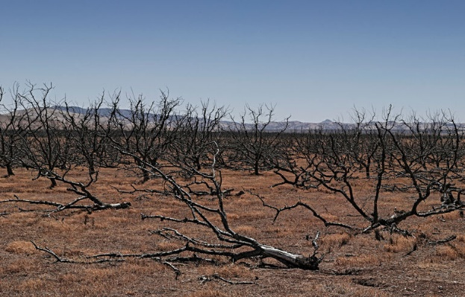
Critical Components to Valuing Economic Costs of Flow Restrictions
Three NMFS, USFWS, and CDFW proposals:
Disregard that land in drought years often becomes permanently fallow or sustains irreversible damages to tree crops
Disregard the permanent fallowing of land and destruction of tree crops
Do not account for reduced lease rent of land and property
Do not account for farms in TID less than 250 acres
Do not account for diminished property value and lost taxes

Slide 17
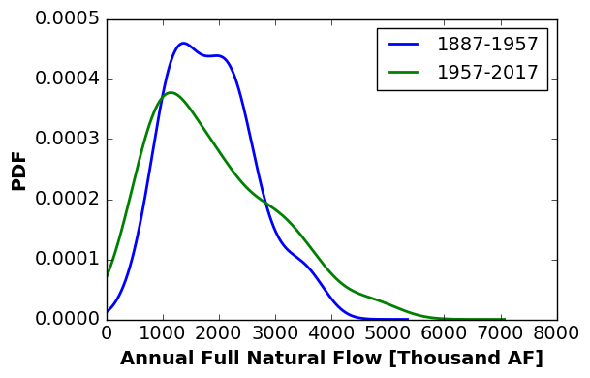
Growing Variability of Water Flows
Histogram of natural stream flows shows a significant departure in variability of flows since 1957
With more frequent and intense droughts expected, TID will face a greater loss in value to agriculture under the proposed river flow requirements
Increasing probability of wet years
Increasing probability of dry years

Slide 18
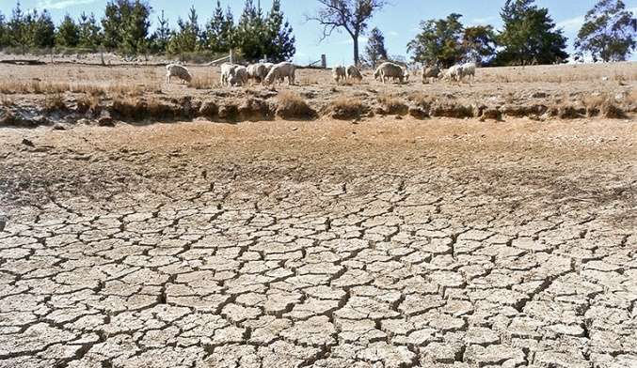
Agricultural and Economic Consequences
Greater water variability leads to crop reductions and devaluation; agricultural losses; dairy losses; population migration;
and property value, income, and revenue losses

Slide 19
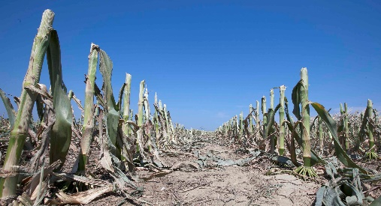
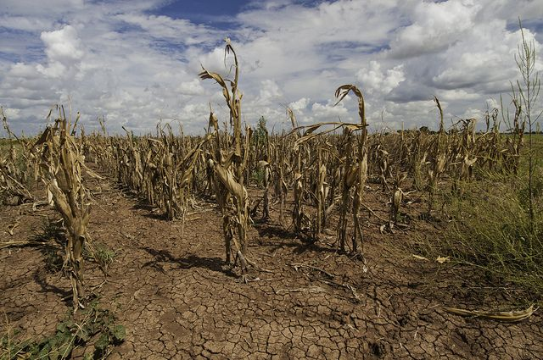
Losses in Crop Valuation
Greatest damages to crops occur during multiyear droughts, after the first year of drought. Under the proposals, Don Pedro would typically have enough water reserves to reach current levels of water deliveries during a single drought year only
Agriculture is hardest hit in the most critically dry years (2014–2015). Ascend assumes increased groundwater use in the worst years: not a long-term solution

Slide 20
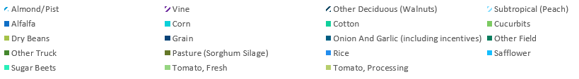
Changing Crop Acreage (1 of 2)
Notes:
Delete?

Slide 21
Changing Crop Acreage (2 of 2)
Irreversible damage to permanent crops due to heavy flow restrictions
Almond and Walnut crops never fully recover from damages
Notes:
Delete?

Slide 22
Irreversible Losses in Agricultural Value from Damaged Trees
Even in periods with little to no reductions in water deliveries relative to baseline, TID continues to lose agricultural output due to the residual losses of almond trees during past drought years
NPV of total losses from 2001–2015:
  NMFS = $239.2 MM
  USFWS = $246 MM
  CDFW = $111 MM

Slide 23
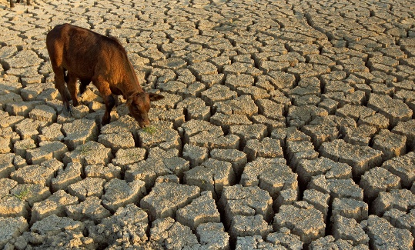
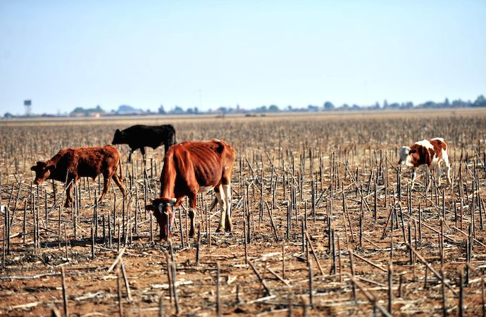
Dairy Industry Effects
Beef processing and milk processing are water intensive processes
Water reduction across different flow scenarios will cause semi-permanent migration of dairy industry from Turlock to other areas
Water requirement for dairy industry:
        Milking cows - 115 L/day per cow
        Feedlot beef cattle – 41 L/day per cow
High damages in Dry and Critically Dry years for dairy production

Slide 24
Population Migration
Tree crops are a primary economic driver of the region; their persistent damage during dry years causes downstream business opportunities erode
  Population migration occurs, with the reduction in population having a permanent effect on the regional economy

Slide 25
Regional Income Loss
The loss in agricultural output coupled with the decreasing population causes systemic losses in income to the region
NPV of income over study period:
  NMFS - $118 MM
  USFWS - $119 MM
  CDFW - $90 MM

Slide 26
Property Values Losses
As a result of water reductions during multi-year droughts & the destruction of permanent crops, property values decline and never rebound

Slide 27
Tax Revenue Losses
Ascend estimates tax revenue to be 1.25% of property values and 7% of annual income

Slide 28
Financial Losses
$510 Million to $844 Million loss for the study period
$287 Million to $408 Million loss annually

Slide 29
Total Damages by Proposed Restriction
Damages under the Ascend Analysis (2001–2015)
Proposal | NMFS | USFWS | CDFW
Loss In Agricultural Profits | $239 MM | $265 MM | $111 MM
Loss in Total Income | $118 MM | $120 MM | $90 MM
Loss in Tax Revenue | $39 MM | $39 MM | $25 MM
Average Loss in Property Value | $319 MM | $324 MM | $228 MM
Dairy Industry Damages | $104.4 MM | $95.6 MM | $56.2 MM
Total Damages | $819.4 MM | $843.6 MM | $510.2 MM

Slide 30
Average Annual Losses
Average Annual Damages (average year of flow restriction implementation)
Proposal | NMFS | USFWS | CDFW
Loss in Agricultural Revenue | $27.6 MM | $27.3 MM | $15.1 MM
Loss in Total Income | $17.0 MM | $17.3 MM | $14.3 MM
Loss in Tax Revenue | $5.4 MM | $5.5 MM | $4.0 MM
Loss in Property Value | $342 MM | $346 MM | $245 MM
Dairy Losses | $13 MM | $11.4 MM | $9.2 MM
Overall Average Annual Damages | $405 MM | $407.5 MM | $287.6 MM

Slide 31
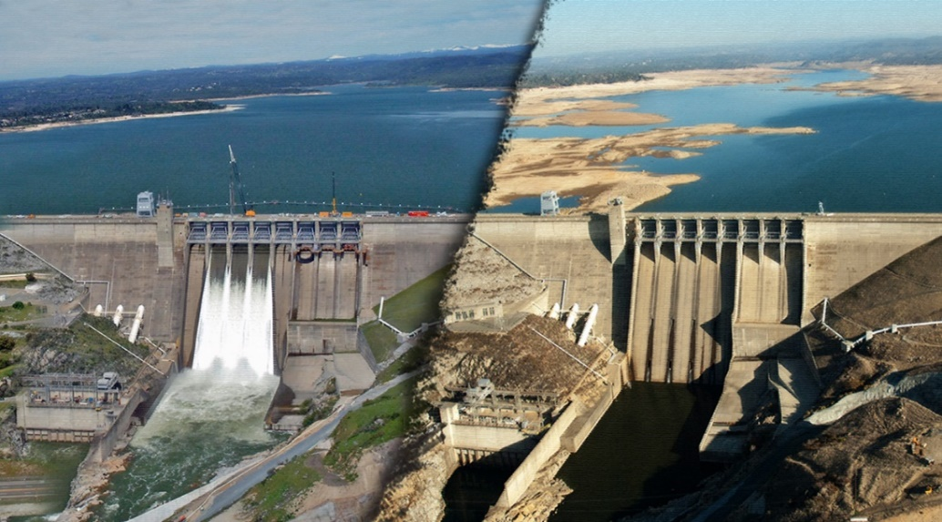
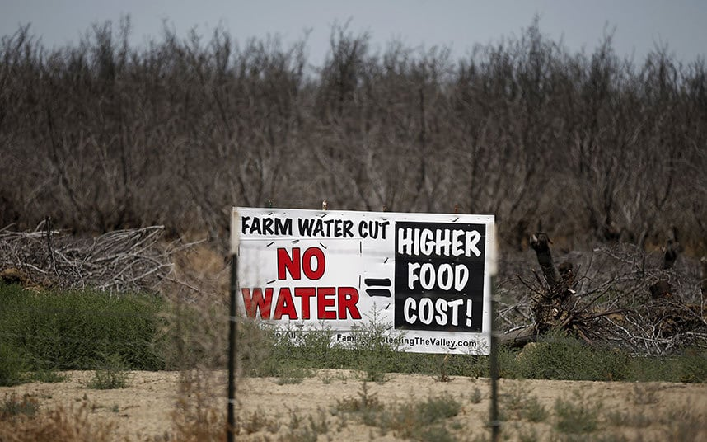
Conclusion
Economic analysis of the current proposals reveal a number of factors omitted
Deep analysis of the economic effect of increased water diversions clearly shows that it will lead to no economic or community benefits
Given the increasing variable climate, water rights are necessary to ensure a sustainable future of agriculture and to allow for the agricultural sector to continue high contributions to the state of California
Let’s keep California as the top producer of agriculture by not implementing water diversions. Farmers deserve water rights!

Slide 32
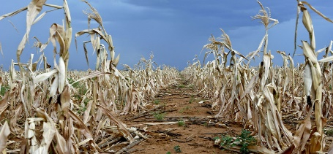
Extra Slides
Methodology (2 slides)
Methodology: analysis of ripple effects (2 slides)
Turlock: one-third of population employed by agricultural industry
UC Davis IMPLAN multiplier limitations
Ascend analysis of ripple effect caused loss of agricultural output
(6 slides)

Slide 33
Methodology (1 of 2)
Ascend developed a general equilibrium model that determines damages through two phases, following a causality chain that explains how changes in explanatory variables affect response variables
  Econometrically modeling available irrigated acreage, based upon water inputs provided by TID’s historical analysis
  Assessing agricultural revenue with a linear optimization model that maximizes yearly agricultural profits

Slide 34
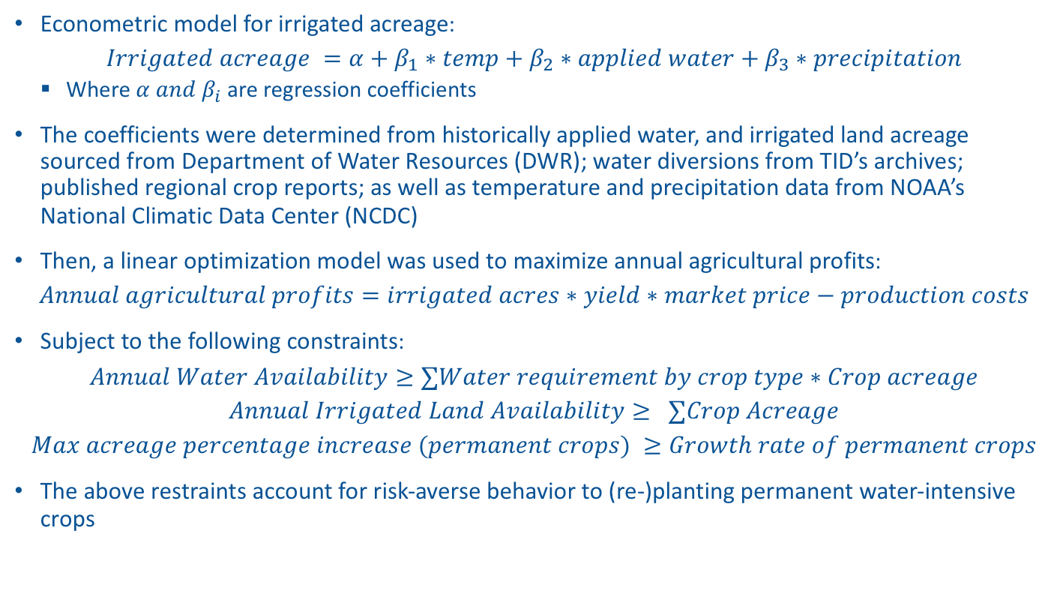
Methodology (2 of 2)
Econometric model for irrigated acreage:
$$Irrigated acreage =α+β_{1}∗temp+β_{2}∗applied water+β_{3}∗precipitation$$
  Where $α and β_{i}$ are regression coefficients
The coefficients were determined from historically applied water, and irrigated land acreage sourced from Department of Water Resources (DWR); water diversions from TID’s archives; published regional crop reports; as well as temperature and precipitation data from NOAA’s National Climatic Data Center (NCDC)
Then, a linear optimization model was used to maximize annual agricultural profits:
$$Annual agricultural profits=irrigated acres∗yield∗market price−production costs$$
Subject to the following constraints:
$$Annual Water Availability≥∑Water requirement by crop type∗Crop acreage$$
$$Annual Irrigated Land Availability≥ ∑Crop Acreage$$
$$Max acreage percentage increase (permanent crops) ≥Growth rate of permanent crops$$
The above restraints account for risk-averse behavior to (re-)planting permanent water-intensive crops

Slide 35

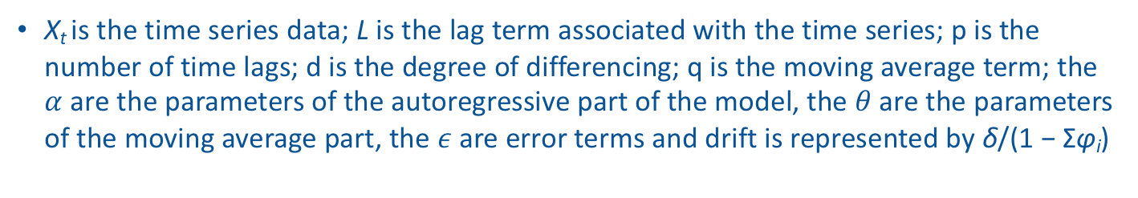
Methodology: Analysis of Ripple Effects (1 of 2)
Regional Income loss: Percent changes in irrigated acreage are superimposed as percentage changes in income losses resulting from direct losses of agriculture output from the acreage difference. Income losses are the difference of the product of population under the scenarios and expected average income
Regional population change is then calculated by fitting an ARIMA model over historical regional population levels recorded during historical critical drought years
  Accounting for the semi-permanent effects of migration, the ARIMA model incorporates a time-lagged “drift” term
  The model does not immediately revert the population back to its original state after a large migration
  The ARIMA with drift model is represented as:
X_{t} is the time series data; L is the lag term associated with the time series; p is the number of time lags; d is the degree of differencing; q is the moving average term; the $α$ are the parameters of the autoregressive part of the model, the $θ$are the parameters of the moving average part, the $ε$ are error terms and drift is represented by δ/(1 − Σφ_{i})

Slide 36
Methodology: Analysis of Ripple Effects (2 of 2)
Property value: The weight average of land values calculated by crop type
The year-by-year change in property valuation is calculated by fitting the ARIMA model to percentage changes in population for the baseline and the alternative cases
Tax revenue: Calculated as 1.25% property value, and 7% of per capita income

Slide 37
Turlock: one-third of population employed by agricultural industry
Turlock

Slide 38
Limitations with the UC Davis IMPLAN Multiplier
IMPLAN multiplier excludes some forms of proprietor income: payments to households from interest, rents, royalties, dividends and corporate profits
  These are key parts of many farmers’ incomes
Does not adequately capture expenditure patterns of mid-level and small agricultural operations that participate more directly in local and regional food systems.
  In TID, approximately 55% of farms are 100 acres or less and 20% are between 100 and 250 acres
Does not adequately account for adjustments that growers and the supporting economy would have to make with new restrictions
  For example, a smaller dairy operation will likely not be able to switch to a sorghum operation in the short-term
Does not take into account market conditions and forward-looking decisions by economic actors
  The water reductions in question lead to enduring losses caused by policy, rather than the temporary losses caused by droughts

Slide 39
Ascend Analysis: Ripple Effects
The following slides presents Ascend’s analysis of the
ripple effects caused by the loss in agricultural output

Slide 40
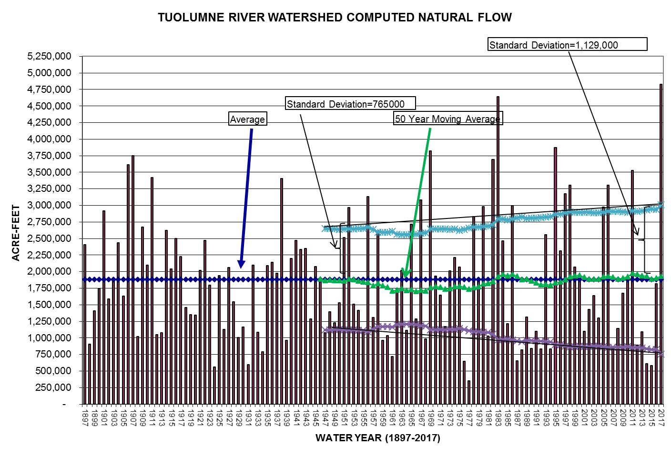
Growing Variability of Water Flows
Variability in natural flows is continuing to increase through time
There is a higher probability of Dry and Critically Dry Years in the future

Slide 41
Percent Reduction Under Proposed Flow Schedule:
Historical Analysis (1922–2015)
The worst water reductions under the proposals occur in multiyear droughts
In particularly harsh drought years (1977, 2014), reductions can reach 95%–100%

Slide 42
Reduction of Water Under Proposed Flow Schedules: Historical Analysis (1922–2015)
Water diversions impact are punishing during critically dry years
 | Percent Reduction of Water Diversions by Water Year Type (1922–2015)
Water Year Type | NMFS | USFWS | CDFW
Average Wet Years (W) | 0% | 0.2% | 0.1%
Average Above Normal Years (AN) | 2.2% | 2.5% | 0.5%
Average Below Normal Years (BN) | 7.7% | 9.6% | 1.2%
Average Dry years (D) | 7.3% | 8.0% | 3.5%
Average Critically Dry Years (C) | 38.5% | 35.1% | 38.1%
Average All Years | 11.3% | 11.1% | 9.4%
Notes:
Could delete this slide??

Slide 43
Annual Losses in Agricultural Revenue
Average Annual Losses in Agricultural Revenue ($ MM)
Proposal | NMFS | USFWS | CDFW
All Years | $27.6 MM | $27.3 MM | $15.1 MM
Drought Years | $31.8 MM | $31.5 MM | $19.9 MM
Critically Dry Years | $40.1 MM | $30.3 MM | $38.9 MM
*Drought years defined as Critically Dry, Dry, and Below Normal Water years

Slide 44
Standard Calculations in Proposals Total Losses
UC Davis IMPLAN Multiplier is a standard method used to calculate overall damages in agricultural proposals NMFS, USFWS, CDFW
Overall Damages (2001–2015) with UC Davis Regional Multiplier
Proposal | NMFS | USFWS | CDFW
Loss in Agricultural Revenue (NPV) | $239 MM | $246 MM | $111 MM
Indirect and Induced Losses in Economic Value (Using IMPLAN Multiplier for Indirect impacts) | $230 MM | $236 MM | $106 MM
Overall Damages | $469 MM | $482 MM | $217 MM
UC Davis, Measure of California Agriculture, (2009),http://aic.ucdavis.edu/publications/moca/moca09/moca09.pdf.
Notes:
The UC Davis IMPLAN value-added multiplier for agriculture’s indirect and induced impacts in the San Joaquin Valley is 1.96
The UC Davis IMPLAN value-added multiplier for indirect and induced impacts in the San Joaquin Valley is 1.26

Slide 45
Annual Losses with UC Davis Regional Multiplier
Overall (NPV) Annual Damages with UC Davis Regional Multiplier
Proposal | NMFS |  | USFWS |  | CDFW
Water Year Type | Average Year | Drought Year* | Average Year | Drought Year | Average Year | Drought Year
Loss in Agricultural Revenue | $27.6 MM | $31.8 MM | $27.3 MM | $31.5 MM | $15.1 MM | $19.9 MM
Indirect Losses (IMPLAN multiplier) | $26.5 MM | $30.5 MM | $26.2 MM | $30.3 MM | $14.5 MM | $19.1 MM
Overall Annual Damages | $54.1 MM | $62.3 MM | $53.6 MM | $61.8 MM | $29.6 MM | $39.1 MM
*Drought years defined as Critically Dry, Dry, and Below Normal Water years
Notes:
Delete?

